Slide 1
Walmart Data Analysis
File created on: 8/3/2022 7:36:48 AM

Slide 2
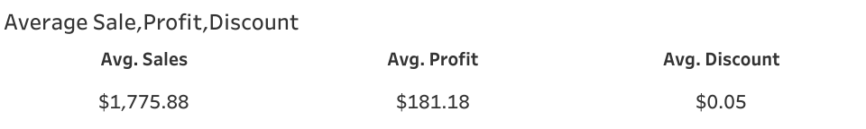

Slide 3
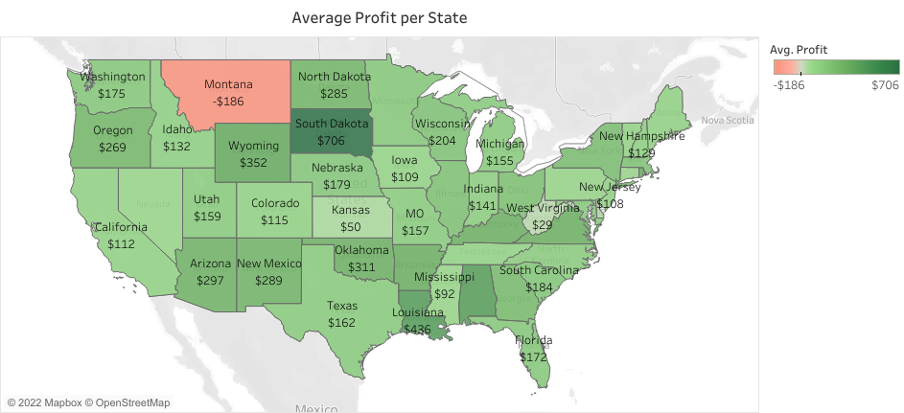

Slide 4
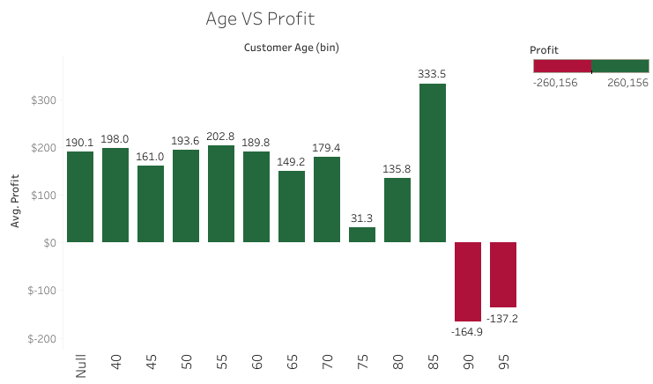

Slide 5
